Slide 1
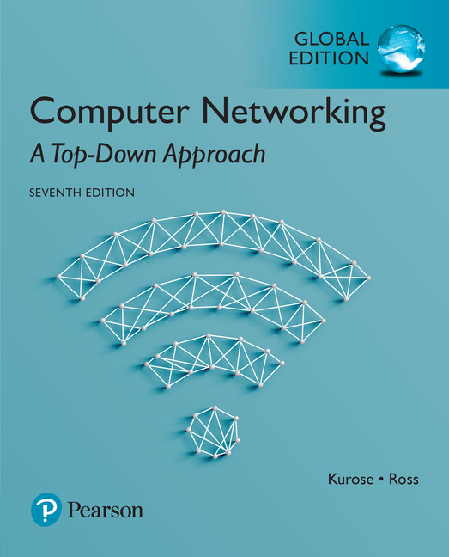
Chapter 7 Wireless and
Mobile Networks
Computer Networking: A Top Down Approach
7th Edition, Global Edition Jim Kurose, Keith Ross Pearson April 2016

Slide 2
Ch. 6: Wireless and Mobile Networks
Background:
# wireless (mobile) phone subscribers now exceeds # wired phone subscribers (5-to-1)!
# wireless Internet-connected devices equals # wireline Internet-connected devices
laptops, Internet-enabled phones promise anytime untethered Internet access
two important (but different) challenges
wireless: communication over wireless link
mobility: handling the mobile user who changes point of attachment to network
Notes:
tether [ˈteðə(r)] n. （拴牲畜用的）系绳;限度，极限 vt. 用绳拴住;拘束，束缚
无线性：无线家庭或办公网络；移动性：开车上网 无线并不总是代表移动性

Slide 3
Chapter 7 outline
7.1 Introduction
Wireless
7.2 Wireless links, characteristics
CDMA
6.73 IEEE 802.11 wireless LANs (“Wi-Fi”)
67.4 Cellular Internet Access
architecture
standards (e.g., 3G, LTE)
Mobility
7.5 Principles: addressing and routing to mobile users
7.6 Mobile IP
7.7 Handling mobility in cellular networks
7.8 Mobility and higher-layer protocols

Slide 4




Elements of a wireless network
network
infrastructure

Slide 5


Elements of a wireless network
wireless hosts
laptop, smartphone
run applications
may be stationary (non-mobile) or mobile
wireless does not always mean mobility
network
infrastructure
Notes:
Stationary静止

Slide 6

Elements of a wireless network
base station
typically connected to wired network
relay - responsible for sending packets between wired network and wireless host(s) in its “area”
e.g., cell towers, 802.11 access points
network
infrastructure
Notes:
cell towers, 802.11 access points 蜂窝塔和无线AP

Slide 7
Elements of a wireless network
wireless link
typically used to connect mobile(s) to base station
also used as backbone link
multiple access protocol coordinates link access
various data rates, transmission distance
network
infrastructure
Notes:
multiple access protocol coordinates link access 多路访问协议协调链路访问

Slide 8
Characteristics of selected wireless links
1300
802.11 ac
450
802.11n
54
802.11a,g
802.11a,g point-to-point
5-11
802.11b
4G: LTWE WIMAX
4
3G: UMTS/WCDMA-HSPDA, CDMA2000-1xEVDO
Data rate (Mbps)
1
802.15
.384
2.5G: UMTS/WCDMA, CDMA2000
.056
2G: IS-95, CDMA, GSM
Indoor
10-30m
Outdoor
50-200m
Mid-range
outdoor
200m – 4 Km
Long-range
outdoor
5Km – 20 Km
Notes:
GSM--Global System for Mobile communication 全球移动通信系统

Slide 9
Elements of a wireless network
infrastructure mode
base station connects mobiles into wired network
handoff: mobile changes base station providing connection into wired network
network
infrastructure
Notes:
handoff n. 手递手传球 （美式足球) 给球；传球；越区切换

Slide 10
Elements of a wireless network
ad hoc mode
no base stations
nodes can only transmit to other nodes within link coverage
nodes organize themselves into a network: route among themselves

Slide 11
Wireless network taxonomy
single hop
multiple hops
host connects to
base station (WiFi,
WiMAX, cellular)
which connects to
larger Internet
host may have to
relay through several
wireless nodes to
connect to larger
Internet: mesh net
infrastructure
(e.g., APs)
no base station, no
connection to larger
Internet. May have to
relay to reach other
a given wireless node
MANET, VANET
no
infrastructure
no base station, no
connection to larger
Internet (Bluetooth,
ad hoc nets)
Notes:
taxonomy 美 [tækˈsɑ:nəmi] n. （生物）分类学，分类系统
单跳，基于基础设施：基站与无线网络之间所有通信都经过一个无线跳，如Wifi, 蜂窝电话（本章学习重点）
单跳，无基础设施：无基站，如蓝牙，具有自组织模式的802.11网络（ad hoc ）
多跳，基于基础设施：为了连接基站，要通过其他无线结点中继通信；无线传感网络，无线网状网络
多跳，无基础设施：移动自组织网络，车载自组织网络（当前研究主题）

Slide 12
Chapter 7 outline
7.1 Introduction
Wireless
7.2 Wireless links, characteristics
CDMA
7.3 IEEE 802.11 wireless LANs (“Wi-Fi”)
7.4 Cellular Internet Access
architecture
standards (e.g., 3G, LTE)
Mobility
7.5 Principles: addressing and routing to mobile users
7.6 Mobile IP
7.7 Handling mobility in cellular networks
7.8 Mobility and higher-layer protocols

Slide 13
Wireless Link Characteristics (1)
important differences from wired link ….
decreased signal strength: radio signal attenuates as it propagates through matter (path loss)
interference from other sources: standardized wireless network frequencies (e.g., 2.4 GHz) shared by other devices (e.g., phone); devices (motors) interfere as well
multipath propagation: radio signal reflects off objects ground, arriving at destination at slightly different times
…. make communication across (even a point to point) wireless link much more “difficult”
Notes:
attenuate 美 [əˈtɛnjuˌeit] vt.& vi. 减弱;（使）变细;（使）变薄;（使）变小
path loss路径损耗
interference from other sources：无线电话与802.11b都用2.4GHz频带，会相互干扰，也会受电动机、微波等干扰

Slide 14
Wireless Link Characteristics (2)
SNR: signal-to-noise ratio
larger SNR – easier to extract signal from noise (a “good thing”)
dB(分贝)
SNR versus BER tradeoffs
given physical layer: increase power -> increase SNR->decrease BER
given SNR: choose physical layer that meets BER requirement, giving highest thruput
SNR may change with mobility: dynamically adapt physical layer (modulation technique, rate)
10⁻¹
10⁻²
10⁻³
BER
10⁻⁴
10⁻⁵
10⁻⁶
10⁻⁷
10
20
30
40
SNR(dB)
QAM256 (8 Mbps)
QAM16 (4 Mbps)
BPSK (1 Mbps)
Notes:
接收方收到的信号是经过退化形式（衰减和多路径传播引起）和背景噪声的结合体，而衡量接收信号好坏的两个指标：SNR和BER
tradeoff n. （公平）交易，折衷，权衡
对一个给定调制方案，SNR越高（可通过增加其传输功率），BER越低，但当该功率超过某个阈值时则实际增益不大，且须更多能量（如用电池供电的移动用户）
给定SNR，调制技术的速率越高，BER越高，如SNR为10时，BPSK的BER<10^-7，而QAM16的BER约为10^-1，基本不可用

Slide 15


Wireless network characteristics
Multiple wireless senders and receivers create additional problems (beyond multiple access):
A
B
C
C
A’s signal
strength
C’s signal
strength
B
A
Hidden terminal problem
B, A hear each other
B, C hear each other
A, C can not hear each other means A, C unaware of their interference at B
space
Signal attenuation (fading):
B, A hear each other
B, C hear each other
A, C can not hear each other interfering at B
Notes:
interference 美 [ˌɪntərˈfɪrəns] n. 干涉，干扰
signal attenuation 信号衰减( fading )
隐藏终端问题和信号衰减问题导致多路访问协议的复杂性，即AC不能相互探测到对方正在通信，在B处产生干扰

Slide 16
Code Division Multiple Access (CDMA)
unique “code” assigned to each user; i.e., code set partitioning
all users share same frequency, but each user has own “chipping” sequence (i.e., code) to encode data
allows multiple users to “coexist” and transmit simultaneously with minimal interference (if codes are “orthogonal”)
encoded signal = (original data) X (chipping sequence)
decoding: inner-product of encoded signal and chipping sequence
Notes:
三种媒体访问协议：信道划分、随机访问、轮流，CDMA属于信道划分
code set partitioning代码集分割
coexist 英 [ˌkəʊɪgˈzɪst] 美 [ˌkoʊɪgˈzɪst] vi. 同时共存，和平共处
orthogonal 美 [ɔ:‘θɒgənəl] adj. [数]直角的;矩形的;直交的;互相垂直的；正交
chipping sequence 片序列

Slide 17
CDMA encode/decode
channel output Z_{i,m}
Z_{i,m}= d_{i}.c_{m}
data
bits
d₀ = 1
1
1
1
1
1
d₁ = -1
1
1
1
-
-
-
-
1
-
-
-
1
-
1
1
1
1
1
sender
1
1
slot 1
channel
output
slot 0
channel
output
1
1
1
1
1
code
1
1
-
-
-
1
-
1
1
1
-
-
-
1
-
1
1
1
slot 1
slot 0
M
D_{i} = Σ Z_{i,m}.c_{m}
m=1
M
received
input
1
1
1
1
1
1
1
1
d₀ = 1
-
-
-
-
1
-
-
-
1
-
1
1
1
1
1
1
d₁ = -1
1
slot 1
channel
output
slot 0
channel
output
1
1
1
1
1
code
1
1
-
-
-
1
-
1
1
1
-
-
-
1
-
1
1
1
receiver
slot 1
slot 0

Slide 18
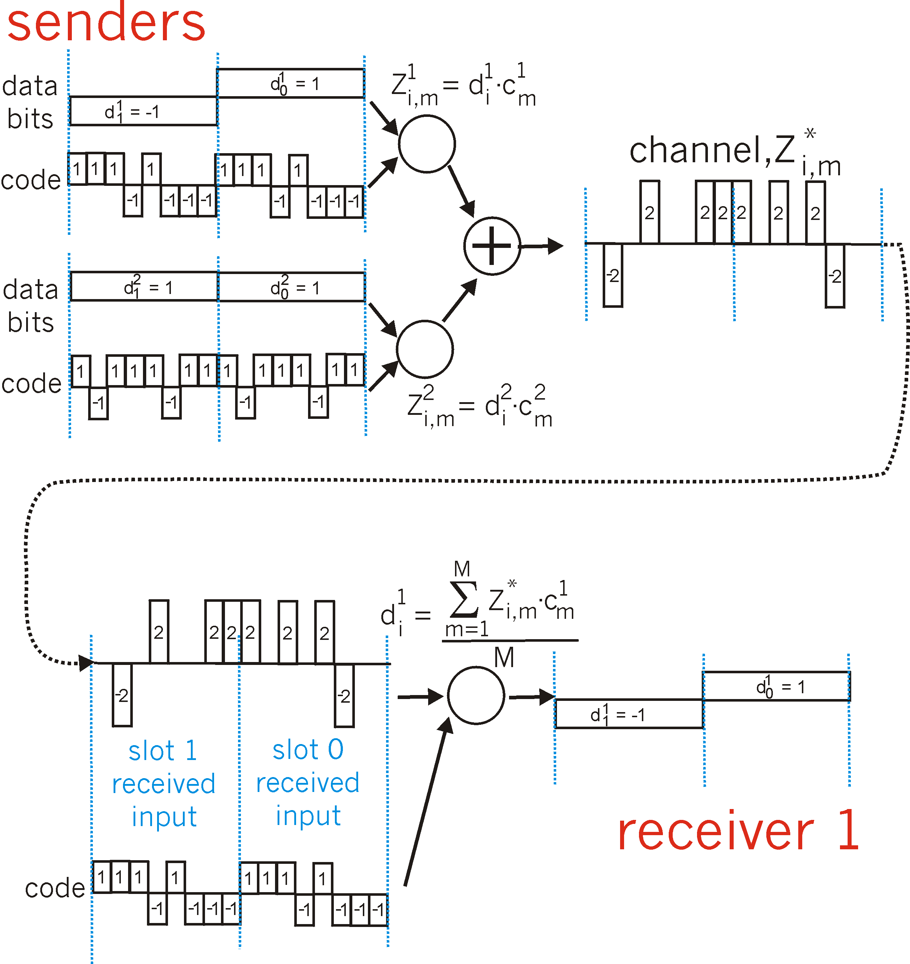
CDMA: two-sender interference
channel sums together transmissions by sender 1 and 2
Sender 1
Sender 2
using same code as sender 1, receiver recovers sender 1’s original data from summed channel data!
Notes:
CDMA的要点：必须仔细选择发送方编码，各编码间必须是正交关系

Slide 19
Chapter 7 outline
7.1 Introduction
Wireless
7.2 Wireless links, characteristics
CDMA
7.3 IEEE 802.11 wireless LANs (“Wi-Fi”)
7.4 Cellular Internet Access
architecture
standards (e.g., 3G, LTE)
Mobility
7.5 Principles: addressing and routing to mobile users
7.6 Mobile IP
7.7 Handling mobility in cellular networks
7.8 Mobility and higher-layer protocols

Slide 20
IEEE 802.11 Wireless LAN
802.11b
2.4-2.4835 GHz unlicensed spectrum
up to 11 Mbps
direct sequence spread spectrum (DSSS) in physical layer
all hosts use same chipping code
802.11a
5.1-5.8 GHz range
up to 54 Mbps, shorter distance
802.11g (more popular)
2.4-2.485 GHz range
up to 54 Mbps
802.11n: multiple antennae 2012
2.4 and 5 GHz range
up to 450 Mbps
802.11ac: multiple antennae 2013-15
5 GHz range
up to 1300 Mbps
all use CSMA/CA for multiple access
all three use the same frame structure for their frame
all have the ability to reduce their transmission rate to reach out over greater distances.
all have base-station and ad-hoc network versions
Notes:
2.4-2.4835 GHz unlicensed spectrum未授权频谱,与2.4G电话和微波炉争用频谱
direct sequence spread spectrum 直接序列扩频
antennae 美 [æn'teni:] n. 天线;天线;触角，触须( antenna [ænˈtenə]的名词复数 );[天线]

Slide 21




802.11 LAN architecture
wireless host communicates with base station
base station = access point (AP)
Basic Service Set (BSS) (aka “cell”) in infrastructure mode contains:
wireless hosts
access point (AP): base station
ad hoc mode: hosts only
Internet
hub, switch
or router
BSS 1
BSS 2

Slide 22
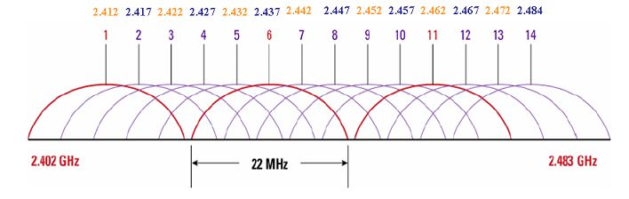
802.11: Channels, association
802.11b: 2.4GHz-2.485GHz spectrum (85MHz) divided into 11 channels at different frequencies
AP admin chooses frequency for AP
其中1、6、11这三个信道（实线标记）之间完全不重叠，它们之间信号互不干扰。这也是路由器自动设定信道，多采用1、6、11的原因所在。
不重叠信道还有（2、7、12）、（3、8、13）、（4、9、14）
Notes:
802.11: Channels, association信道与关联

Slide 23
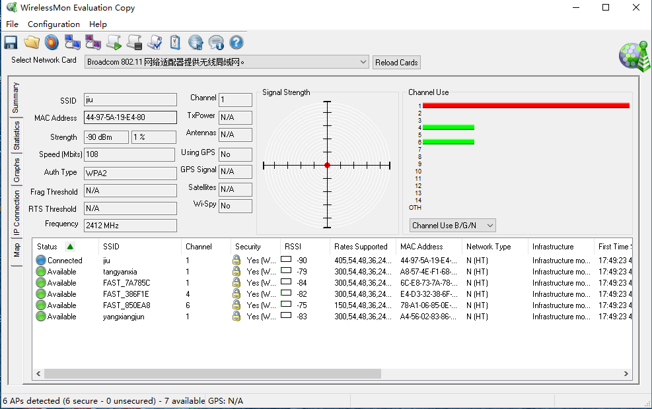
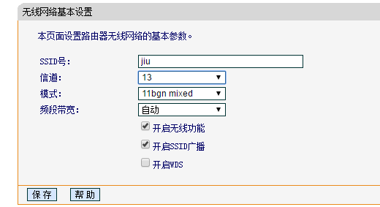
802.11: Channels, association
802.11b: 2.4GHz-2.485GHz spectrum (85MHz) divided into 11 channels at different frequencies
interference possible: channel can be same as that chosen by neighboring AP!
WirelessMon工具可以监控无线适配器和聚集的状态，显示无线信道的诸多信息等
可以看到，这里连的是“jiu”，信道为1，而信道1有4个AP，很拥堵。
Notes:
802.11: Channels, association信道与关联

Slide 24
802.11: Channels, association
host: must associate with an AP
scans channels, listening for beacon frames containing AP’s name (SSID, Service Set Identifier) and MAC address
selects AP to associate with
may perform authentication
based on MAC address
employs usernames and passwords
will typically run DHCP to get IP address in AP’s subnet
Notes:
802.11: Channels, association信道与关联
beacon frames 信标帧

Slide 25


802.11: passive/active scanning
WiFi Jungle
WiFi Jungle
BBS 1
BBS 2
BBS 1
BBS 2
1
AP 2
AP 1
1
1
AP 2
2
2
2
AP 1
3
3
4
H1
H1
passive scanning:
beacon frames sent from APs
association Request frame sent: H1 to selected AP
association Response frame sent from selected AP to H1
active scanning:
Probe Request frame broadcast from H1
Probe Response frames sent from APs
Association Request frame sent: H1 to selected AP
Association Response frame sent from selected AP to H1
Notes:
beacon frames 信标帧

Slide 26



IEEE 802.11: multiple access
multiple devices may want to transmit data at the same time over the same channel – MAC protocol
avoid collisions: 2⁺ nodes transmitting at same time
802.11: CSMA - sense before transmitting
don’t collide with ongoing transmission by other node
802.11: no collision detection! (difference from 802.3)
difficult to receive (sense collisions) when transmitting due to weak received signals (fading)
can’t sense all collisions in any case: hidden terminal, fading
goal: avoid collisions: CSMA/C(ollision)A(voidance)
A
B
C
C
B
A’s signal
strength
C’s signal
strength
A
space

Slide 27
IEEE 802.11 MAC Protocol: CSMA/CA
802.11 sender
1 if sense channel idle for DIFS then
transmit entire frame (no CD)
2 if sense channel busy then
start random backoff time
timer counts down while channel idle
transmit when timer expires
if no ACK, increase random backoff interval, repeat 2
802.11 receiver
- if frame received OK
return ACK after SIFS (ACK needed due to hidden terminal problem)
sender
receiver
DIFS
data
SIFS
ACK
Notes:
SIFS：Short Interframe Space(SIFS):在802.11系列无线局域网中SIFS是固定值，SIFS是短帧间间隔，因此采用SIFS的节点具有访问无线链路的最高优先级。它等于节点从发送状态切换到接收状态并能正确解码所需要的时间，或者从接收状态转为发送状态所需要的时间，在SIFS过期后可能发送的数据包包括ACK、CTS帧，不同标准中规定的SIFS值不同。
Standard SIFS(μs) IEEE 802.11b 10 IEEE 802.11a 16 IEEE 802.11g 10
DIFS：Distributed Inter-frame Space(DIFS,分布式帧间间隔):节点在开始发送数据之前需要监测信道是否空闲。如果信道已经空闲，则节点仍需等待DIFS段时间才开始发送数据（这是避免两个节点同时发现信道空闲了，并同时发送数据，随机选一个DIFS等待值，只要两者不同，就不会发生碰撞，所以叫冲突避免）；而如果在DIFS时间段内任一时刻信道被监测为忙，则节点不得不推迟它的数据发送。DIFS和SIFS间的计算关系如下：DIFS = SIFS + (2 * Slot time)
Standard Slot Time(µs) DIFS(µs) IEEE 802.11b 20 50 IEEE 802.11a 9 34 IEEE 802.11g 9 or 20 28 or 50
PIFS：PCF Interframe Space(PIFS):PCF使得AP等待PIFS而不是DIFS时间以访问信道，由于DIFS > PIFS > SIFS，因此AP总比普通节点具有更高的访问信道的优先级。
PIFS = SIFS + Slot time
Standard Slot time(µs) PIFS(µs) IEEE 802.11b 20 30 IEEE 802.11a 9 25 IEEE 802.11g 9 or 20 19 or 30
EIFS：Extended Interframe Space(EIFS):在前一帧出错的情况下，发送节点不得不延迟EIFS而不是DIFS时间段后再发送下一帧。
EIFS = Transmission time of Ack frame at lowest basic rate + SIFS + DIFS

Slide 28
Avoiding collisions (more)
Dealing with Hidden Terminals: RTS and CTS
idea: allow sender to “reserve” channel rather than random access of data frames: avoid collisions of long data frames
sender first transmits small request-to-send (RTS) packets to BS using CSMA
RTSs may still collide with each other (but they’re short)
BS broadcasts clear-to-send (CTS) in response to RTS
CTS heard by all nodes
sender transmits long data frame
other stations defer transmissions
avoid data frame collisions completely
using small reservation packets!
Notes:
defer 美 [dɪˈfɚ] vt. 使推迟;使延期
BS-base station

Slide 29


Collision Avoidance: RTS-CTS exchange
A
B
AP
RTS(B)
RTS(A)
reservation collision
RTS(A)
CTS(A)
CTS(A)
DATA (A)
defer
time
ACK(A)
ACK(A)

Slide 30
802.11 frame: addressing
2
2
6B
6B
6B
2
6B
0 - 2312
4
frame
control
duration
address
1
address
2
address
3
seq
control
address
4
payload
CRC
Address 4: used only in ad hoc mode
Address 1: MAC address
of wireless host or AP
to receive this frame
dest MAC
Address 3: MAC address
of router interface to which AP is attached
Address 2: MAC address
of wireless host or AP
transmitting this frame
source MAC

Slide 31

802.11 frame: addressing
Internet
H1
R1
router
R1 MAC addr H1 MAC addr
dest. address
source address
802.3 frame
AP MAC addr H1 MAC addr R1 MAC addr
address 1
address 2
address 3
802.11 frame
Notes:
地址3在BBS和有线局域网互联中起着关键作用

Slide 32
802.11 frame: more
frame seq #
(for RDT)
duration of reserved
transmission time (RTS/CTS)
2
2
6
6
6
2
6
0 - 2312
4
frame
control
duration
address
1
address
2
address
3
seq
control
address
4
payload
CRC
2
2
4
1
1
1
1
1
1
1
1
Protocol
version
Type
Subtype
To
AP
From
AP
More
frag
Retry
Power
mgt
More
data
WEP
Rsvd
frame type
(RTS, CTS, ACK, data)
whether encryption is
being used

Slide 33

802.11: mobility within same subnet
companies and universities often deploy multiple BSSs within same IP subnet
H1 remains in same IP subnet: IP address can remain same
switch: which AP is associated with H1?
self-learning (Ch. 5): switch will see frame from H1 and “remember” which switch port can be used to reach H1
BBS 1
H1
BBS 2

Slide 34
802.11: advanced capabilities
Rate adaptation
base station, mobile dynamically change transmission rate (physical layer modulation technique) as mobile moves, SNR varies
10⁻¹
10⁻²
10⁻³
BER
10⁻⁴
10⁻⁵
10⁻⁶
10⁻⁷
10
20
30
40
SNR(dB)
1. SNR decreases, BER increase as node moves away from base station
QAM256 (8 Mbps)
QAM16 (4 Mbps)
2. When BER becomes too high, switch to lower transmission rate but with lower BER
BPSK (1 Mbps)
operating point
Notes:
Rate adaptation速率适应
physical layer modulation technique物理层调制技术
如果连续发两个帧而没有收到确认帧，该传输速率就降到前一个较低速率；如果10个帧连续得到确认，则提高到上一个较高的速率

Slide 35
802.11: advanced capabilities
power management
node-to-AP: “I am going to sleep until next beacon frame”
AP knows not to transmit frames to this node
node wakes up before next beacon frame
beacon frame: contains list of mobiles with AP-to-mobile frames waiting to be sent
node will stay awake if AP-to-mobile frames to be sent; otherwise sleep again until next beacon frame
99% of the time can be saved, significant energy saving

Slide 36
802.15: wireless personal area network
WPAN
less than 10 m diameter
replacement for cables (mouse, keyboard, headphones)
ad hoc: no infrastructure
master/slaves:
slaves request permission to send (to master)
master grants requests
802.15.1: evolved from Bluetooth specification
2.4-2.5 GHz radio band (TDM)
up to 721 kbps
S
P
P
radius of
coverage
M
S
S
P
P
M
Master device
Slave device
Parked device (inactive)
S
P
Notes:
无线个人区域网WPAN
Headphone耳机 Parked device 寄放设备

Slide 37
802.15: wireless personal area network
ZigBee - 802.15.4
lower-powered, lower-data-rate, lower-duty-cycle than Bluetooth
Home temperature and light sensors
Security devices
Wall-mounted switches
……
Notes:
lower-duty-cycle低工作周期

Slide 38
Chapter 7 outline
7.1 Introduction
Wireless
7.2 Wireless links, characteristics
CDMA
7.3 IEEE 802.11 wireless LANs (“Wi-Fi”)
7.4 Cellular Internet access
architecture
standards (e.g., 3G, LTE)
Mobility
7.5 Principles: addressing and routing to mobile users
7.6 Mobile IP
7.7 Handling mobility in cellular networks
7.8 Mobility and higher-layer protocols

Slide 39

Components of cellular network architecture
MSC
connects cells to wired tel. net.
manages call setup (more later!)
handles mobility (more later!)
cell
covers geographical region
base station (BS) analogous to 802.11 AP
mobile users attach to network through BS
air-interface: physical and link layer protocol between mobile and BS
Mobile
Switching
Center
Public telephone
network
Mobile
Switching
Center
wired network
Notes:
mobile switching center 移动交换中心

Slide 40

Cellular networks: the first hop
Two techniques for sharing mobile-to-BS radio spectrum
combined FDMA/TDMA: divide spectrum in frequency channels, divide each channel into time slots
CDMA: code division multiple access
time slots
frequency
bands

Slide 41
2G (voice) network architecture
Base station system (BSS)
MSC
BTS
BSC
G
Public
telephone
network
Gateway
MSC
Legend
Base transceiver station (BTS)
Base station controller (BSC)
Mobile Switching Center (MSC)
Mobile subscribers
Notes:
BTS：base transceiver station 收发基站，三个cell也可只用一个 带有向天线的BTS 实现
一个MSC可支持5个BSC

Slide 42
3G (voice+data) network architecture
MSC
G
Public
telephone
network
radio
network
controller
Gateway
MSC
G
Public
Internet
SGSN
Key insight: new cellular data
network operates in parallel
(except at edge) with existing
cellular voice network
voice network unchanged in core
data network operates in parallel
GGSN
Serving GPRS Support Node (SGSN)
Gateway GPRS Support Node (GGSN)
Notes:
3G核心：在原有语音网外，并行加上数据功能
SGSN：serving generalized packet radio service support node服务通用分组无线服务支持结点
GGSN：gateway GPRS support node 网关GPRS支持结点

Slide 43
3G (voice+data) network architecture
MSC
G
Public
telephone
network
radio
network
controller
Gateway
MSC
G
Public
Internet
SGSN
GGSN
radio interface
(WCDMA, HSPA)
radio access network
Universal Terrestrial Radio
Access Network (UTRAN)
core network
General Packet Radio Service
(GPRS) Core Network
public
Internet
Notes:
Universal Terrestrial Radio Access Network 通用陆地无线接入网

Slide 44
3G versus 4G LTE network architecture
MSC
G
Public
telephone
network
3G
radio
network
controller
Gateway
MSC
G
Public
Internet
SGSN
GGSN
4G-LTE
HSS
MME
G
G
Public
Internet
S-GW
P-GW
radio access network
Universal Terrestrial Radio
Access Network (UTRAN)
Evolved Packet Core
(EPC)
Notes:
Evolved Packet Core 演进分组核心网

Slide 45
4G: differences from 3G
all IP core: IP packets tunneled (through core IP network) from base station to gateway
no separation between voice and data – all traffic carried over IP core to gateway
Mobility
Management
Entity (MME)
Home Subscriber
Server(HSS)
(like HLR+VLR)
Serving
Gateway
(S-GW)
Packet data
network
Gateway
(P-GW)
UE
(user element)
eNodeB
(base station)
HSS
MME
control
G
G
Public
Internet
data
S-GW
P-GW
radio access network
Universal Terrestrial Radio
Access Network (UTRAN)
Evolved Packet Core
(EPC)

Slide 46

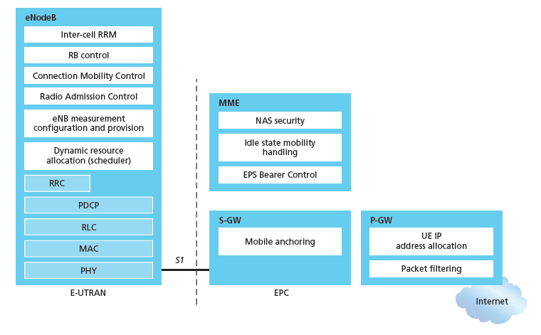
Functional split of major LTE components
handles idle/active UE transitions
pages UE
sets up eNodeB-PGW tunnel (aka bearer)
holds idle UE info
QoS enforcement
Notes:
Bearer持有人

Slide 47

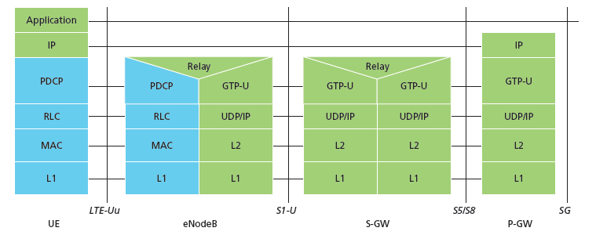
Radio+Tunneling: UE – eNodeB – PGW
IP packet from UE encapsulated in GPRS Tunneling Protocol (GTP) message at ENodeB
GTP message encapsulated in UDP, then encapsulated in IP. large IP packet addressed to SGW
G
G
UE
eNodeB
S-GW
P-GW
tunnel
link-layer radio net

Slide 48
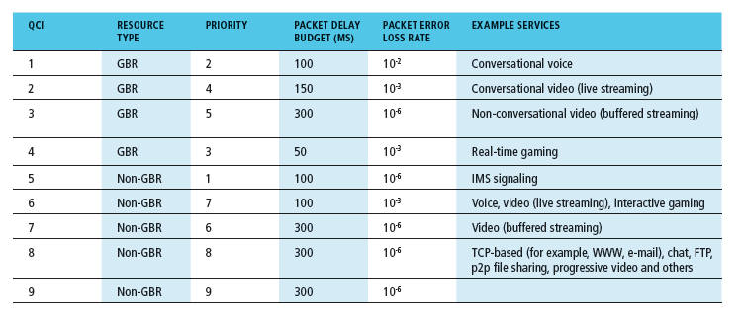
Quality of Service in LTE
QoS from eNodeB to SGW: min and max guaranteed bit rate
QoS in radio access network: one of 12 QCI values

Slide 49
Chapter 7 outline
7.1 Introduction
Wireless
7.2 Wireless links, characteristics
CDMA
7.3 IEEE 802.11 wireless LANs (“Wi-Fi”)
7.4 Cellular Internet Access
architecture
standards (e.g., 3G, LTE)
Mobility
7.5 Principles: addressing and routing to mobile users
7.6 Mobile IP
7.7 Handling mobility in cellular networks
7.8 Mobility and higher-layer protocols
Notes:
移动用户的寻址和路由

Slide 50
What is mobility?
spectrum of mobility, from the network perspective:
no mobility
high mobility
mobile wireless user,
using same access
point
mobile user, connecting/ disconnecting from network using DHCP.
mobile user, passing through multiple access point while maintaining ongoing connections (like cell phone)

Slide 51



Mobility: vocabulary
home network: permanent “home” of mobile
(e.g., 128.119.40/24)
home agent: entity that will perform mobility functions on behalf of mobile, when mobile is remote
wide area network
permanent address: address in home network, can always be used to reach mobile
e.g., 128.119.40.186
Notes:
home network归属网络
当移动设备处于远程状态时，代表移动设备执行移动功能的实体

Slide 52
Mobility: more vocabulary
permanent address: remains constant (e.g., 128.119.40.186)
visited network: network in which mobile currently resides (e.g., 79.129.13/24)
care-of-address （COA）: address in visited network.
(e.g., 79,129.13.2)
wide area network
foreign agent: entity in visited network that performs mobility functions on behalf of mobile.
correspondent: wants to communicate with mobile
Notes:
visited network被访网络 foreign agent外部代理
correspondent n. 通信者 ，想与移动用户通讯的设备
COA

Slide 53

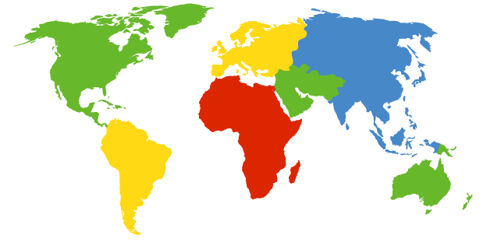

How do you contact a mobile friend:
Consider friend frequently changing addresses, how do you find her?
I wonder where Alice moved to?
search all phone books?
call her parents?
expect her to let you know where he/she is?
Facebook!

Slide 54
Mobility: approaches
let routing handle it: routers advertise permanent address of mobile-nodes-in-residence via usual routing table exchange.
routing tables indicate where each mobile located
no changes to end-systems
let end-systems handle it:
indirect routing: communication from correspondent to mobile goes through home agent, then forwarded to remote
direct routing: correspondent gets foreign address of mobile, sends directly to mobile

Slide 55
Mobility: approaches
let routing handle it: routers advertise permanent address of mobile-nodes-in-residence via usual routing table exchange.
routing tables indicate where each mobile located
no changes to end-systems
let end-systems handle it:
indirect routing: communication from correspondent to mobile goes through home agent, then forwarded to remote
direct routing: correspondent gets foreign address of mobile, sends directly to mobile
not
scalable
to millions of
mobiles

Slide 56
Mobility: registration
visited network
home network
1
2
wide area network
mobile contacts foreign agent on entering visited network
foreign agent contacts home agent home: “this mobile is resident in my network”
end result:
foreign agent knows about mobile
home agent knows location of mobile

Slide 57

Mobility via indirect routing
foreign agent receives packets, forwards to mobile
home agent intercepts packets, forwards to foreign agent
visited
network
home
network
3
wide area network
2
1
correspondent addresses packets using home address of mobile
4
mobile replies directly to correspondent

Slide 58
Indirect Routing: comments
mobile uses two addresses:
permanent address: used by correspondent (hence mobile location is transparent to correspondent)
care-of-address: used by home agent to forward datagrams to mobile
foreign agent functions may be done by mobile itself
triangle routing: correspondent-home-network-mobile
inefficient when
correspondent, mobile
are in same network
Notes:
foreign agent functions may be done by mobile itself外部代理功能可以由移动本身完成
inefficient when correspondent, mobile are in same network当通讯者与被访者在同一网络中时低效，如两个用户挨在一起通讯

Slide 59
Indirect routing: moving between networks
suppose mobile user moves to another network
registers with new foreign agent
new foreign agent registers with home agent
home agent update care-of-address for mobile
packets continue to be forwarded to mobile (but with new care-of-address)
mobility, changing foreign networks transparent: on going connections can be maintained!

Slide 60



Mobility via direct routing
foreign agent receives packets, forwards to mobile
correspondent forwards to foreign agent
visited
network
home
network
3
1
2
4
correspondent requests, receives foreign address of mobile
mobile replies directly to correspondent

Slide 61

Mobility via direct routing: comments
overcome triangle routing problem
non-transparent to correspondent: correspondent must get care-of-address from home agent
what if mobile changes visited network?
3
1
2
4

Slide 62

Accommodating mobility with direct routing
anchor foreign agent: FA in first visited network
data always routed first to anchor FA
when mobile moves: new FA arranges to have data forwarded from old FA (chaining)
foreign net visited
at session start
anchor
foreign
agent
wide area network
2
1
4
5
3
new
foreign
network
correspondent
agent
new foreign
agent
correspondent
Notes:
Accommodating mobility随和的; 乐于助人的; 善于适应新环境的 随机应变

Slide 63
Chapter 7 outline
7.1 Introduction
Wireless
7.2 Wireless links, characteristics
CDMA
7.3 IEEE 802.11 wireless LANs (“Wi-Fi”)
7.4 Cellular Internet Access
architecture
standards (e.g., 3G, LTE)
Mobility
7.5 Principles: addressing and routing to mobile users
7.6 Mobile IP
7.7 Handling mobility in cellular networks
7.8 Mobility and higher-layer protocols

Slide 64
Mobile IP
RFC 3344
has many features we’ve seen:
home agents, foreign agents, foreign-agent registration, care-of-addresses, encapsulation (packet-within-a-packet)
three components to standard:
indirect routing of datagrams
agent discovery
registration with home agent
Notes:
数据报的间接路由选择
代理发现
向归属代理注册

Slide 65

Mobile IP: indirect routing
foreign-agent-to-mobile packet
packet sent by home agent to foreign agent: a packet within a packet
dest: 128.119.40.186
dest: 79.129.13.2
dest: 128.119.40.186
Permanent address: 128.119.40.186
Care-of address: 79.129.13.2
dest: 128.119.40.186
packet sent by correspondent

Slide 66
Mobile IP: agent discovery
agent advertisement: foreign/home agents advertise service by broadcasting ICMP messages (typefield = 9)
H,F bits: home and/or foreign agent
R bit: registration required
Notes:
agent advertisement代理通告，一种路由器发现协议的扩展协议，周期性地在链路上广播一个类型字段为9的ICMP报文

Slide 67


Mobile IP: registration example
visited network: 79.129.13/24
home agent
HA: 128.119.40.7
foreign agent
COA: 79.129.13.2
mobile agent
MA: 128.119.40.186
ICMP agent adv.
COA: 79.129.13.2
….
registration req.
registration req.
COA: 79.129.13.2
HA: 128.119.40.7
MA: 128.119.40.186
Lifetime: 9999
identification: 714
encapsulation format
….
COA: 79.129.13.2
HA: 128.119.40.7
MA: 128.119.40.186
Lifetime: 9999
identification:714
….
registration reply
HA: 128.119.40.7
MA: 128.119.40.186
Lifetime: 4999
Identification: 714
encapsulation format
….
registration reply
HA: 128.119.40.7
MA: 128.119.40.186
Lifetime: 4999
Identification: 714
….
time

Slide 68
6.2 Components of cellular network architecture
recall:
correspondent
wired public telephone
network
MSC
MSC
MSC
MSC
MSC
different cellular networks,
operated by different providers

Slide 69
Handling mobility in cellular networks
home network: network of cellular provider you subscribe to (e.g., Sprint PCS, Verizon)
home location register (HLR): database in home network containing permanent cell phone #, profile information (services, preferences, billing), information about current location (could be in another network)
visited network: network in which mobile currently resides
visitor location register (VLR): database with entry for each user currently in network
could be home network
Notes:
home network归属网络 home location register 归属位置注册器
visited network被访网络 visitor location register 访问者位置注册器

Slide 70

GSM: indirect routing to mobile
HLR
home
network
2
correspondent
home
Mobile
Switching
Center
home MSC consults HLR,
gets roaming number of
mobile in visited network
1
call routed
to home network
3
Public switched
telephone
network
VLR
Mobile
Switching
Center
4
home MSC sets up 2nd leg of call
to MSC in visited network
mobile
user
MSC in visited network completes
call through base station to mobile
visited
network
Notes:
Global System/Standard for Mobile Communication(s)
Groupe Special Mobile

Slide 71
GSM: handoff with common MSC
handoff goal: route call via new base station (without interruption)
reasons for handoff:
stronger signal to/from new BSS (continuing connectivity, less battery drain)
load balance: free up channel in current BSS
GSM doesn't mandate why to perform handoff (policy), only how (mechanism)
handoff initiated by old BSS
VLR
Mobile
Switching
Center
old
routing
new
routing
old BSS
new BSS
Notes:
同一个MSC（mobile switching center）下的切换
less battery drain drain排水; 流干; 喝光，喝干; 使耗尽

Slide 72
GSM: handoff with common MSC
1. old BSS informs MSC of impending handoff, provides list of 1⁺ new BSSs
2. MSC sets up path (allocates resources) to new BSS
3. new BSS allocates radio channel for use by mobile
4. new BSS signals MSC, old BSS: ready
5. old BSS tells mobile: perform handoff to new BSS
6. mobile, new BSS signal to activate new channel
7. mobile signals via new BSS to MSC: handoff complete. MSC reroutes call
8 MSC-old-BSS resources released
VLR
Mobile
Switching
Center
4
2
1
8
7
3
old BSS
5
6
new BSS

Slide 73
GSM: handoff between MSCs
anchor MSC: first MSC visited during call
call remains routed through anchor MSC
new MSCs add on to end of MSC chain as mobile moves to new MSC
optional path minimization step to shorten multi-MSC chain
home network
correspondent
Home MSC
anchor MSC
PSTN
MSC
MSC
MSC
(a) before handoff
Notes:
锚MSC是呼叫首次开始时移动用户所访问的MSC，在整个呼叫过程中保持不变

Slide 74
GSM: handoff between MSCs
anchor MSC: first MSC visited during call
call remains routed through anchor MSC
new MSCs add on to end of MSC chain as mobile moves to new MSC
optional path minimization step to shorten multi-MSC chain
home network
correspondent
Home MSC
anchor MSC
PSTN
MSC
MSC
MSC
(b) after handoff

Slide 75

Handling Mobility in LTE
Paging: idle UE may move from cell to cell: network does not know where the idle UE is resident
paging message from MME broadcast by all eNodeB to locate UE
handoff: similar to 3G:
preparation phase
execution phase
completion phase
source
MME
P-GW
target
MME
old
routing
new
routing
old
eNodeB
new
eNodeB
Notes:
寻呼：空闲UE可能从一个cell移动到另一个cell：网络不知道空闲UE驻留在哪里

Slide 76
Mobility: cellular versus Mobile IP
cellular element |  | Comment on cellular element | Mobile IP element
Home system | Network to which mobile user’s permanent phone number belongs |  |  | Home network
Gateway Mobile Switching Center, or “home MSC”. Home Location Register (HLR) | Home MSC: point of contact to obtain routable address of mobile user. HLR: database in home system containing permanent phone number, profile information, current location of mobile user, subscription information |  |  | Home agent
Visited System | Network other than home system where mobile user is currently residing |  |  | Visited network
Visited Mobile services Switching Center. Visitor Location Record (VLR) | Visited MSC: responsible for setting up calls to/from mobile nodes in cells associated with MSC. VLR: temporary database entry in visited system, containing subscription information for each visiting mobile user |  |  | Foreign agent
Mobile Station Roaming Number (MSRN), or “roaming number” | Routable address for telephone call segment between home MSC and visited MSC, visible to neither the mobile nor the correspondent. |  |  | Care-of-address

Slide 77
Wireless, mobility: impact on higher layer protocols
logically, impact should be minimal …
best effort service model remains unchanged
TCP and UDP can (and do) run over wireless, mobile
… but performance-wise:
packet loss/delay due to bit-errors (discarded packets, delays for link-layer retransmissions), and handoff
TCP interprets loss as congestion, will decrease congestion window un-necessarily
delay impairments for real-time traffic
limited bandwidth of wireless links
Notes:
performance-wise就表现而言
TCP interprets loss as congestion, will decrease congestion window un-necessarilyTCP将损失解释为拥塞，不一定会减少拥塞窗口
Impairment 损害，损伤

Slide 78
Chapter 7 summary
Wireless
wireless links:
capacity, distance
channel impairments
CDMA
IEEE 802.11 (“Wi-Fi”)
CSMA/CA reflects wireless channel characteristics
cellular access
architecture
standards (e.g., 3G, 4G LTE)
Mobility
principles: addressing, routing to mobile users
home, visited networks
direct, indirect routing
care-of-addresses
case studies
mobile IP
mobility in GSM, LTE
impact on higher-layer protocols

